Slide 1
Eye Tracker Comparison Study:
Pupillabs vs. Eyelink
Ehinger, Ibs, König & Groß
Notes:
Hi
I am really excited to give you a quick update
on the etcomp project and present results of
some selected conditions.
First of all I want to say thank you to Bene, Inga and Peter for allowing me to join the etcomp team and their great work in this project.
Tell audience members up front why they should care and what’s in it for them
Let‘s jump right into it:
In the tea time you should have 20 min for presentation and 10 min for discussion
Talk about good and bad accuracy (not high and low)

Slide 2
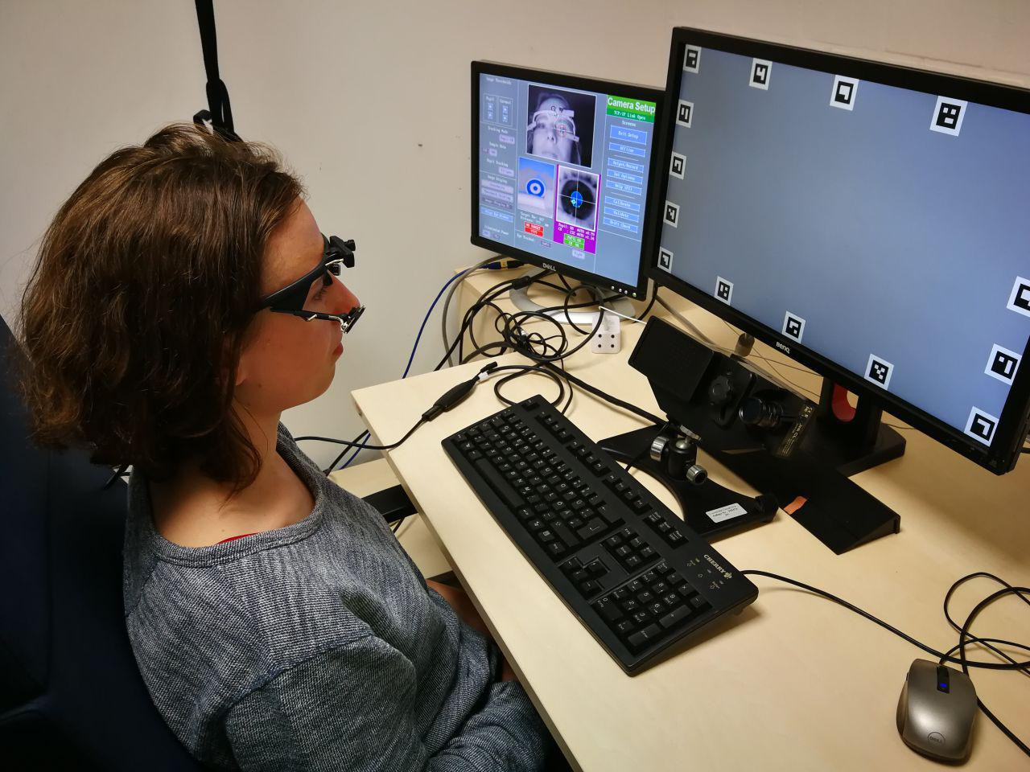
Experimental Setup
Notes:
TODO: change roll and yaw
This was the complete test battery
I will only focus on conditions,
that I analyzed or that are otherwise important for understanding
[read and explain conditions]

Slide 3
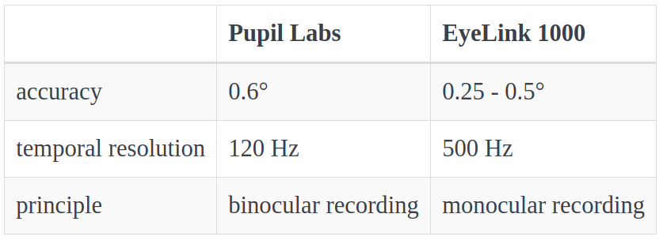
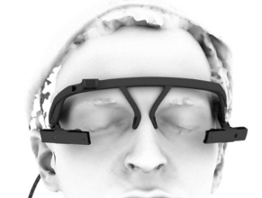
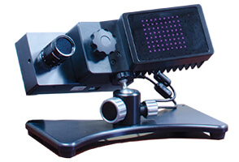
Pupillabs (PL) vs. Eyelink (EL)
- values reported from manufacturers^{1, 2} -
Notes:
* TODO: look up where looked up values
What gap did you think your work could fill?
–> Holquist says:
‘qoute et data quality is important’
The manufacturers report the following
Degree of visual angle (which ...)
But the reasearch on really testing the accuracy and precision of eye trackers is sparse
Lets see what the promises are
We were especially interested in the accuracy of the eyetrackers as the detected fixation location is of major importance for many eye tracking experiments.
Eyeling has sampling frequency of 500 Hz in the head free modus

Slide 4
Data Preprocessing
We developed a flexible Pipeline: Business as usual!
parse messages and combine with gaze data
convert units of measures
explore raw data samples
apply blink and saccade detection algorithms
    ¬ blink & ¬ saccade = fixation
Notes:
Convey your excitement
→ all samples that neither belong to a blink nor to a saccade, are classified as fixations

Slide 5
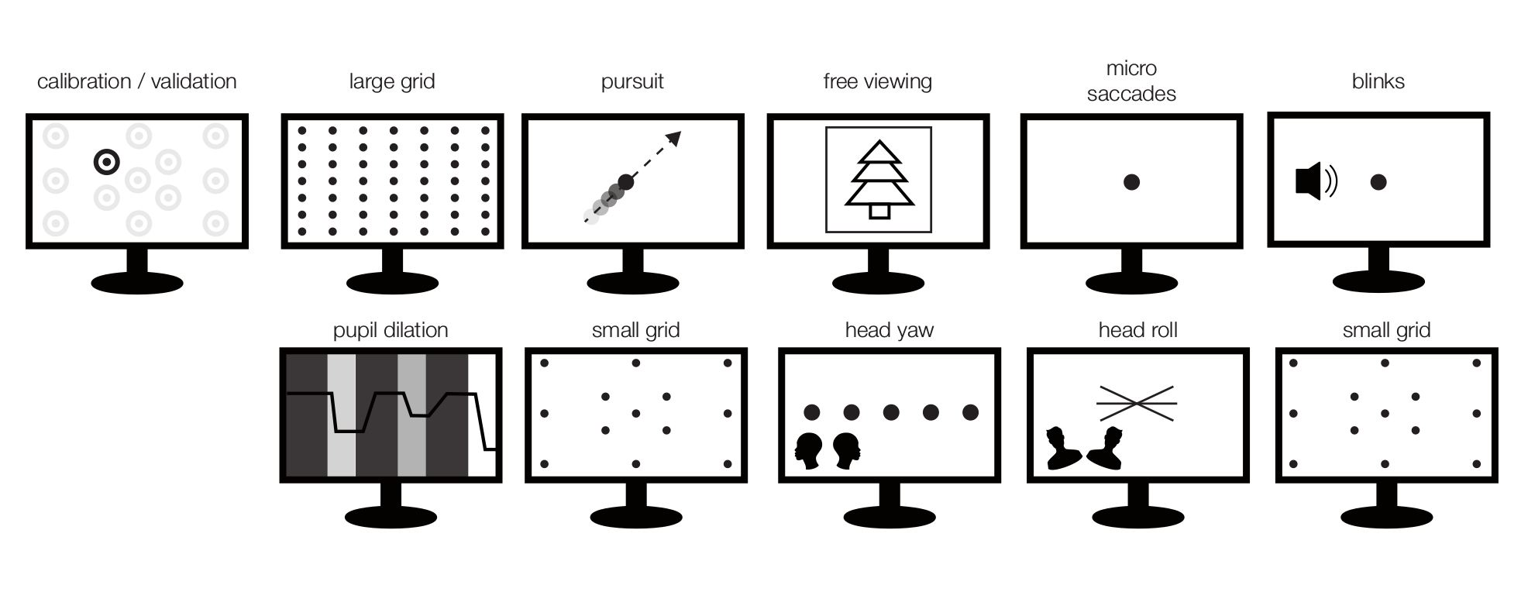
Test Battery
repeated 6 times
15 subjects
Notes:
TODO: change roll and yaw
This was the complete test battery
I will only focus on conditions,
that I analyzed or that are otherwise important for understanding
[read and explain conditions]

Slide 6
Analyzed conditions

Slide 7
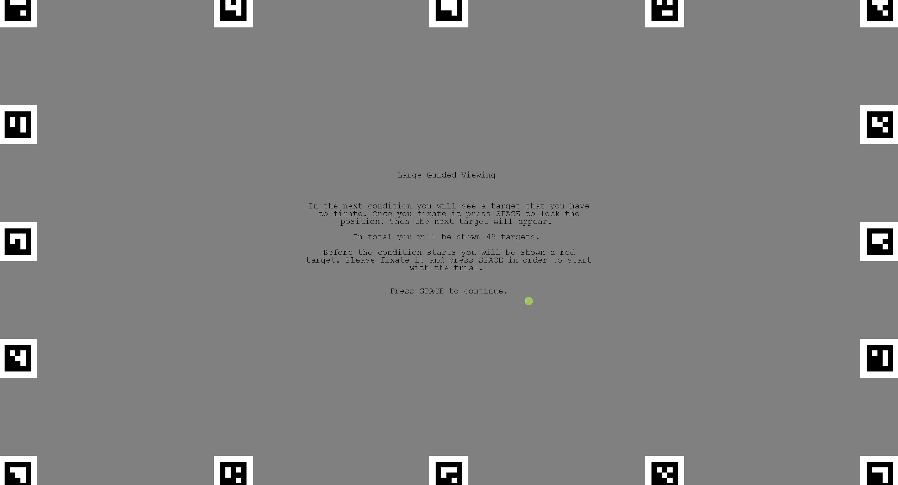
The task:
7x7 grid
Fixate on the targets
Measures:
- Variance of fixation (Accuracy)
Hypotheses:
EL accuracy ~0.5°, PL ~1-2°

Slide 8
Raw Eye Movement Data
Notes:
Small Grid 13 points
Good example
Nur x komponnente!!

Slide 9
Raw Eye Movement Data
Notes:
Bad example

Slide 10
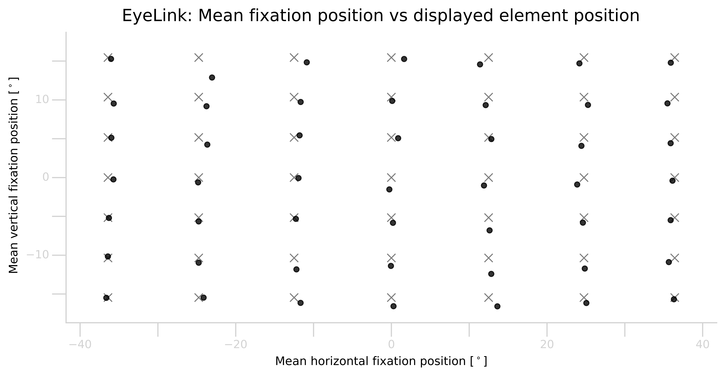
Large Grid Condition
- EyeLink subject VP25 block 2 -

Slide 11
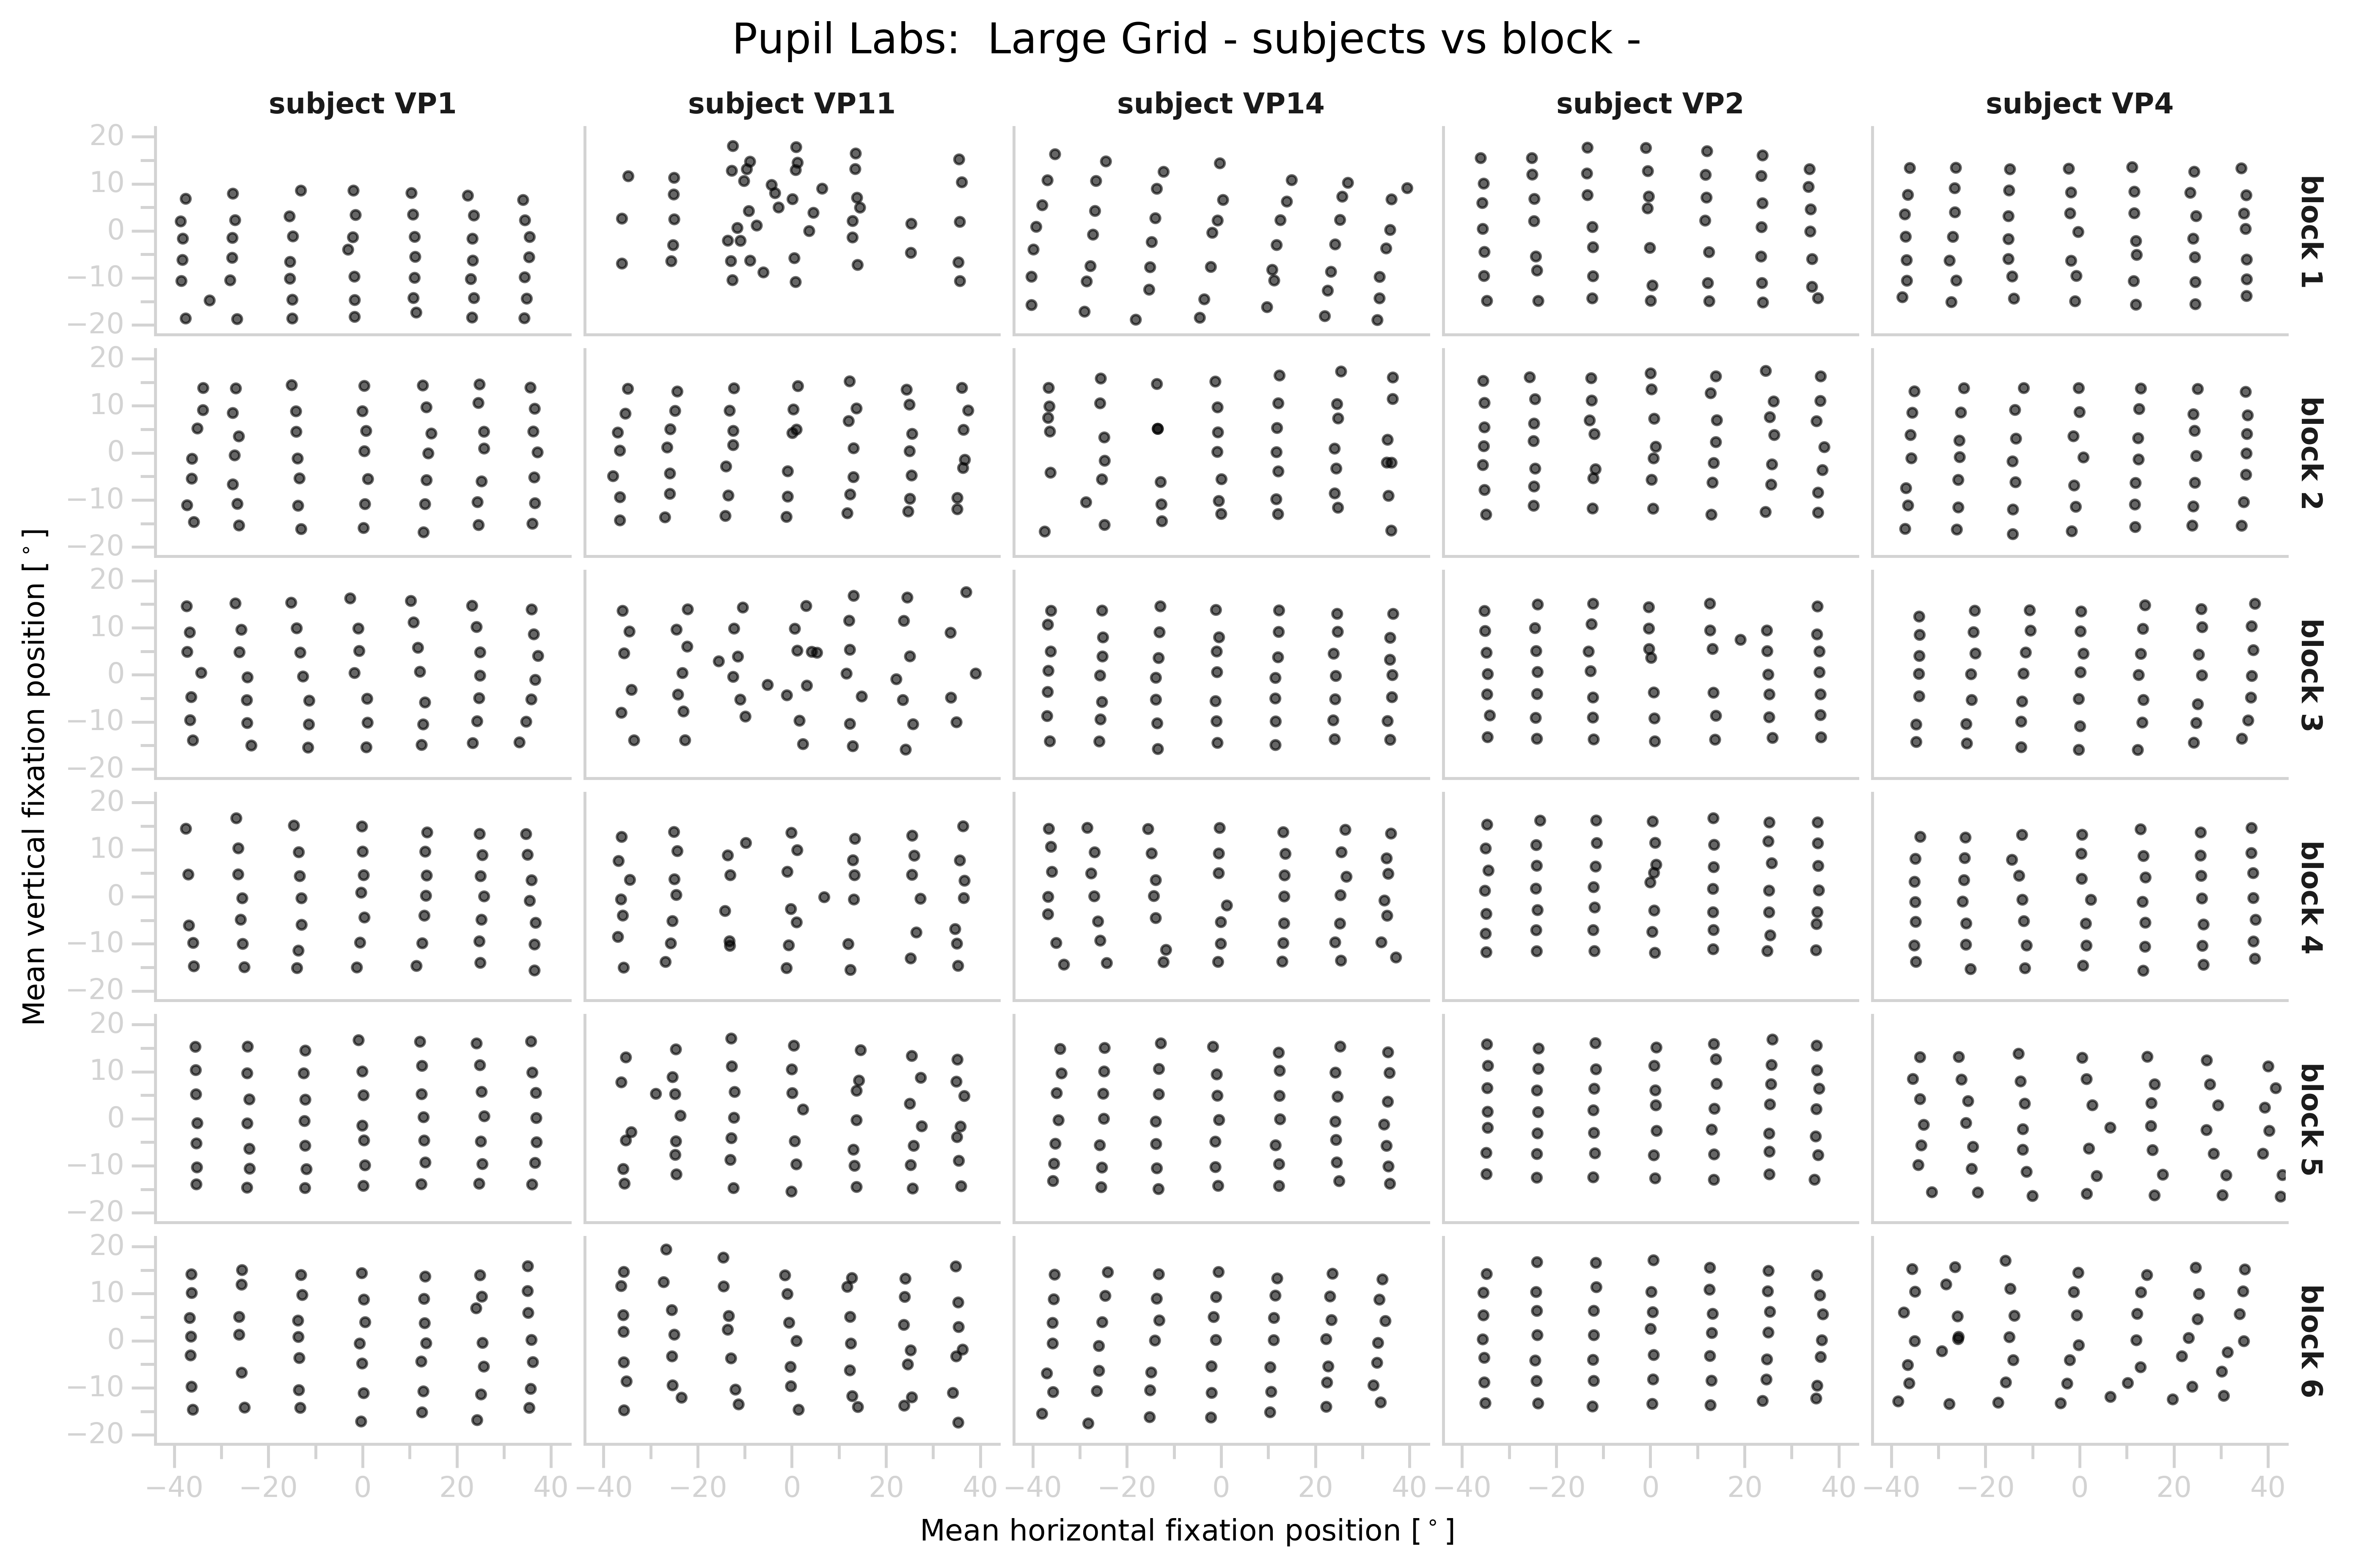
Large Grid Condition
Notes:
Point out:
- generally good
- there are subjects that are difficult to track
- there are subjects that are difficult to track with a certain eye tracker
- there are blocks where the gaze estimation is totally off

Slide 12
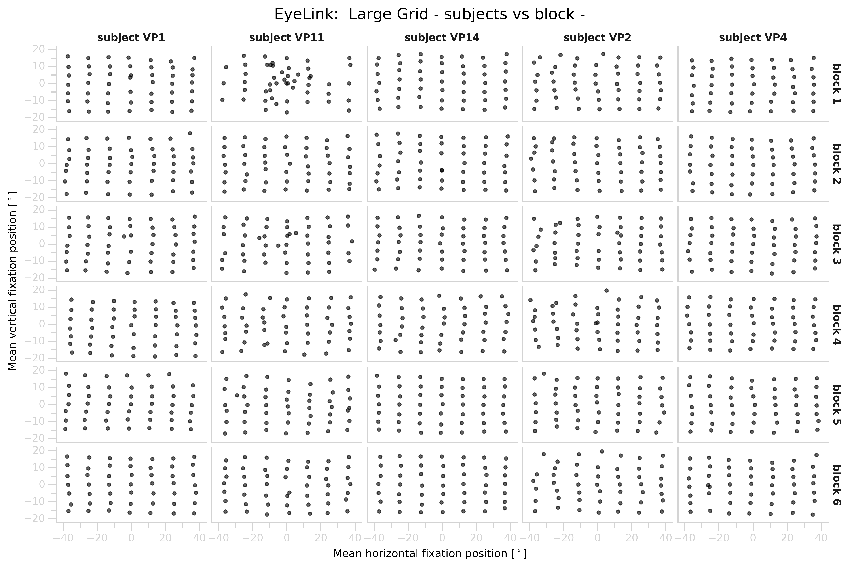
Large Grid Condition

Slide 13
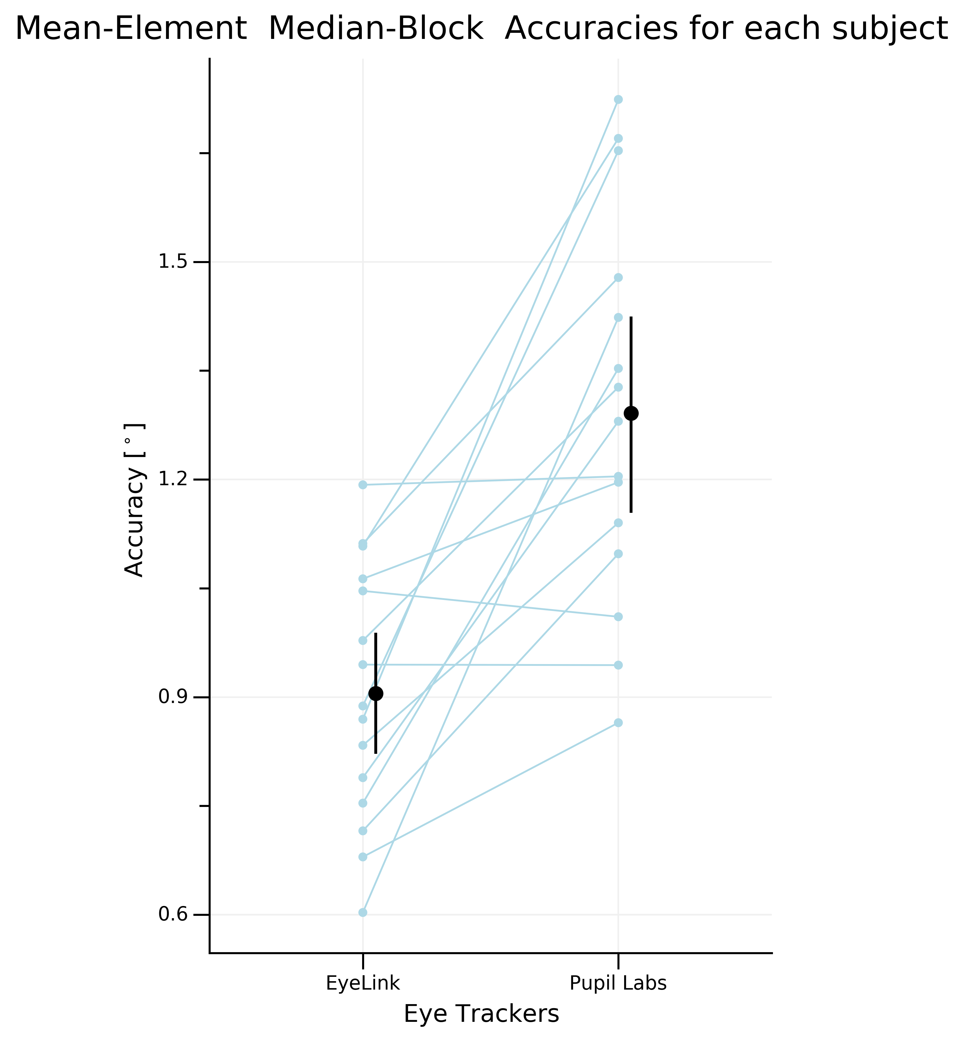

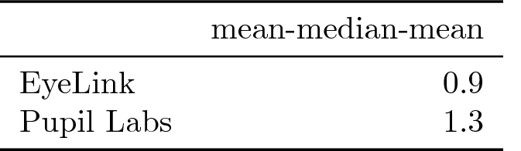
Large Grid Condition
EyeLink performs
surprisingly bad
Pupil Labs performs
surprisingly good

Slide 14
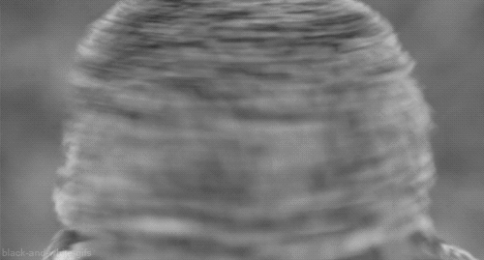
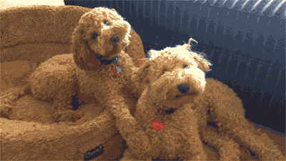
The task:
Fixate on the targets
Measures:
- Accuracy before & after head motion
Hypotheses:
Worse accuracy after headmovement

Slide 15
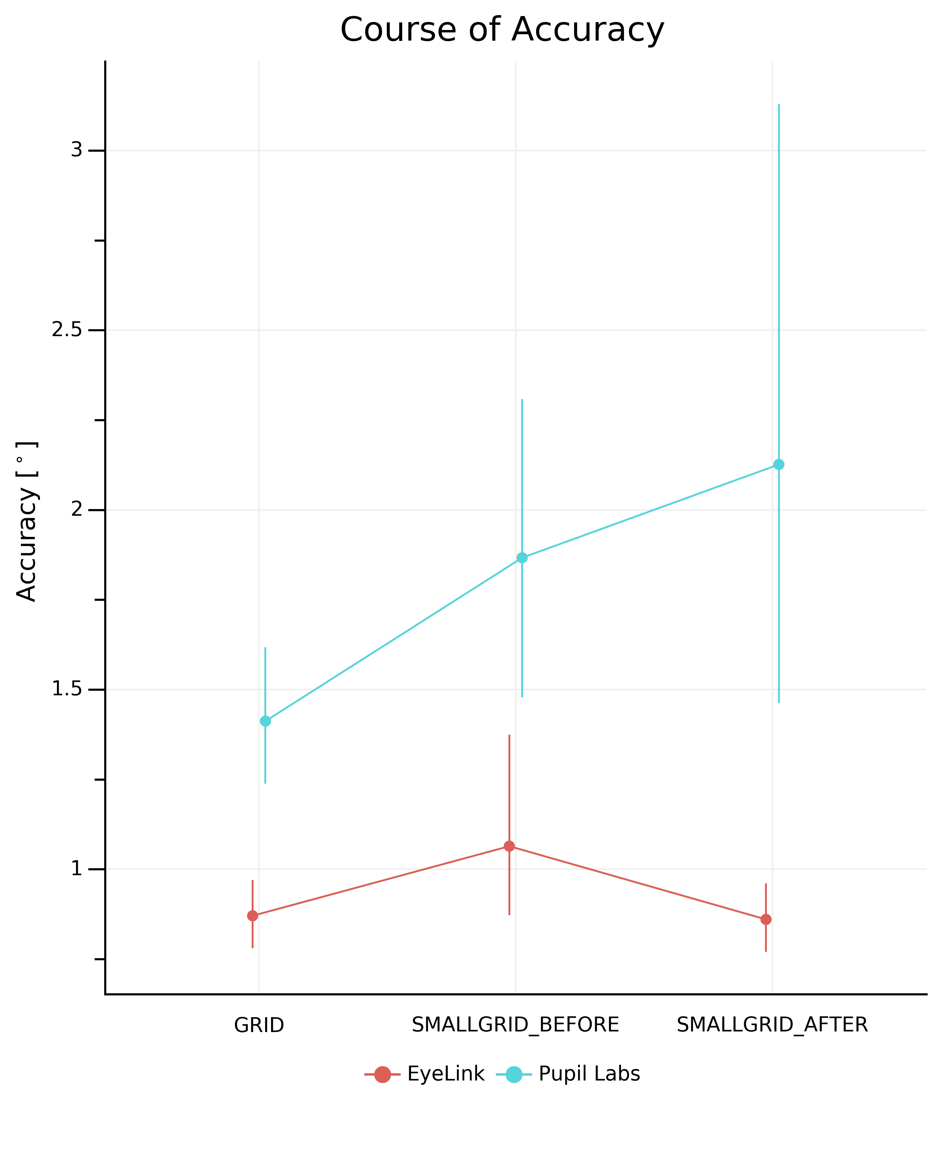
Large & Small Grid Condition
Notes:
Not as expected
- we dont know why
- ideas?
CHANGE of Accuracy throughout the experiment in grid conditions based on 13 elements

Slide 16

The task:
3 images / block
6 seconds / image
Measures:
- Central fixation bias
- Number of fixations
- Fixation durations
Hypotheses:
- none -

Slide 17
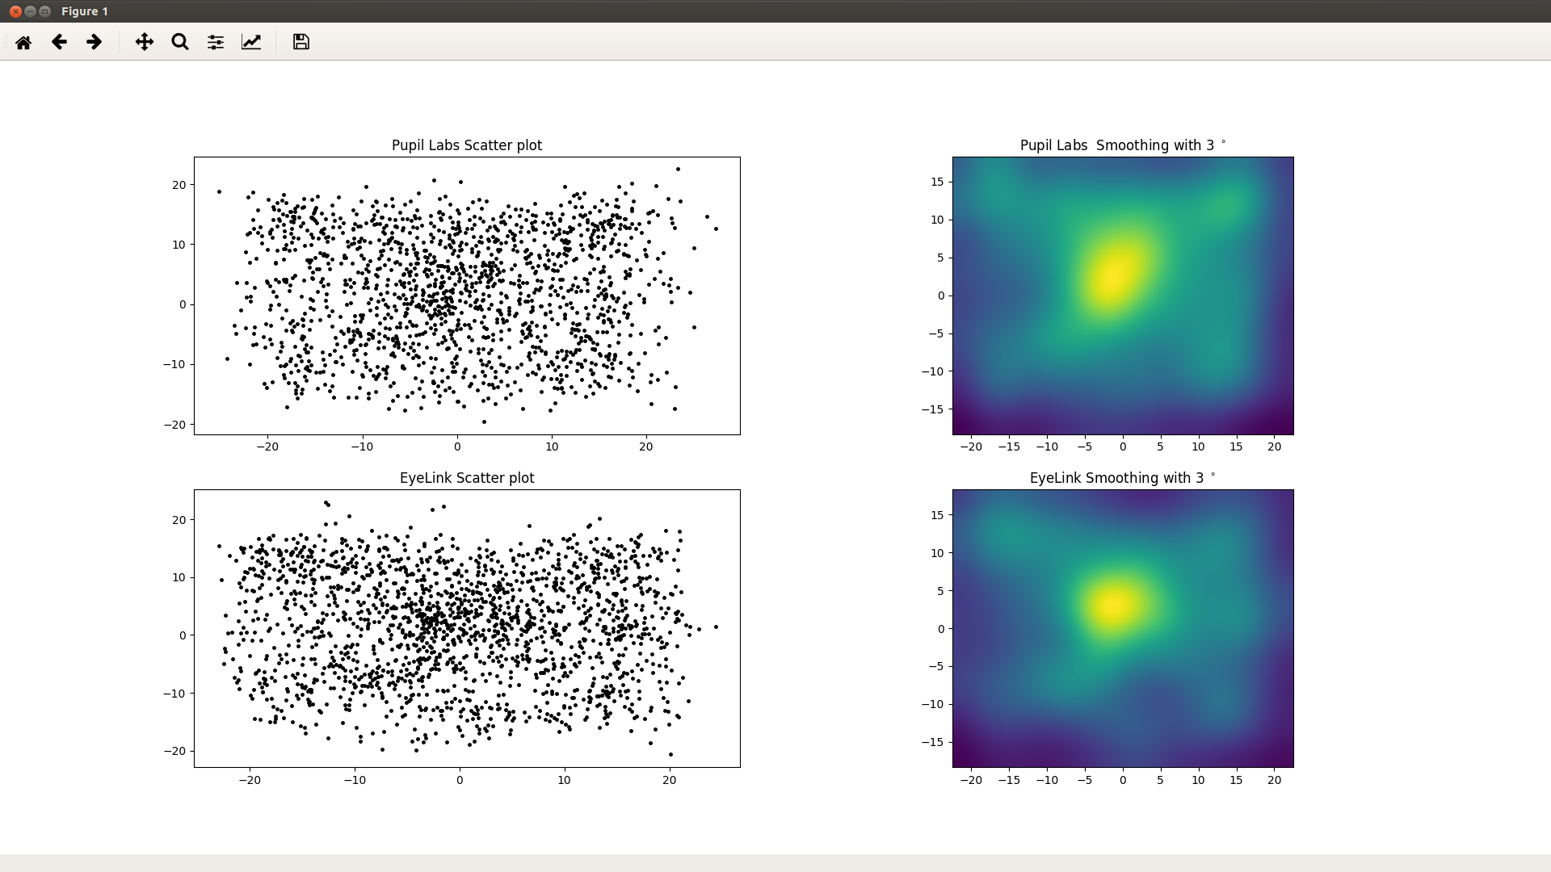
Freeviewing
- Central Fixation Bias -

Slide 18
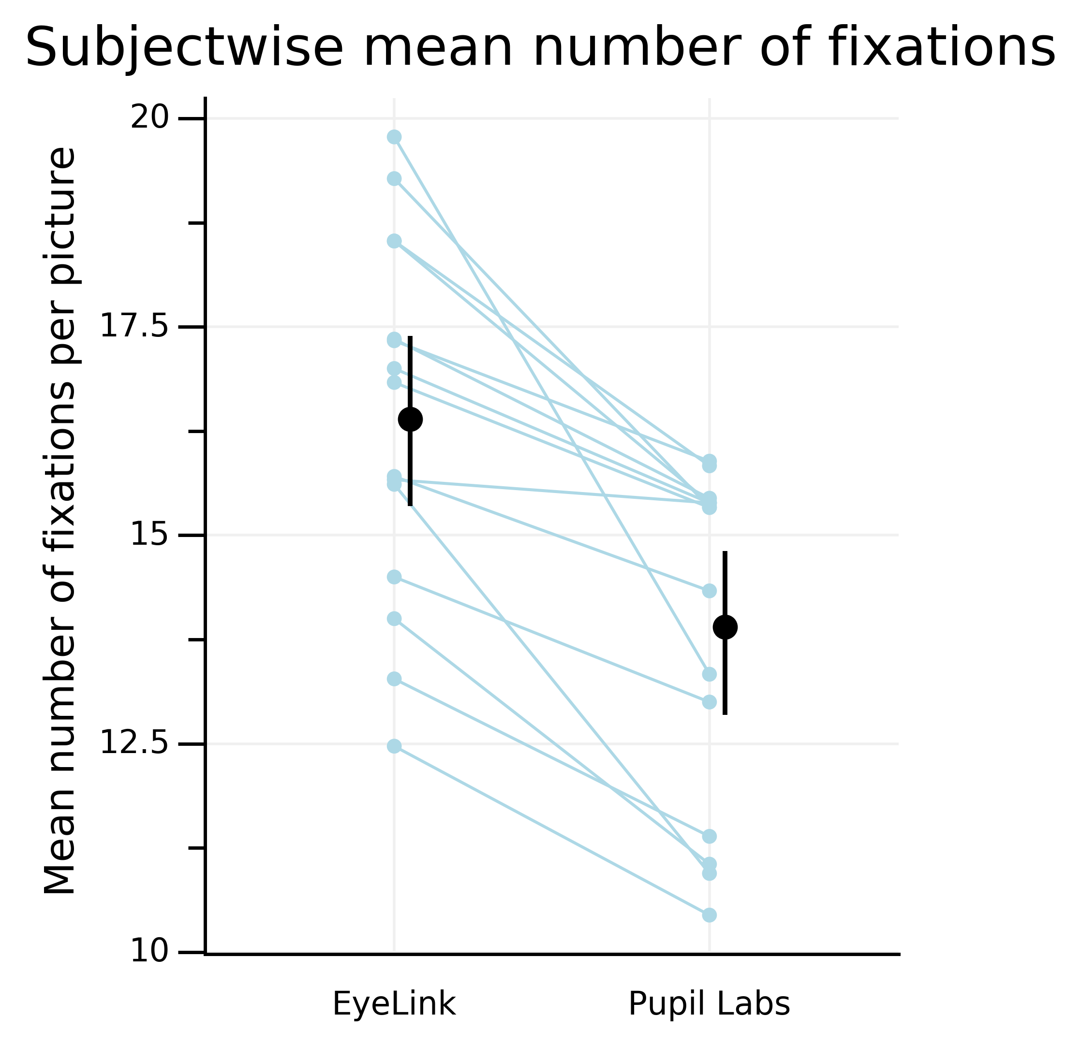
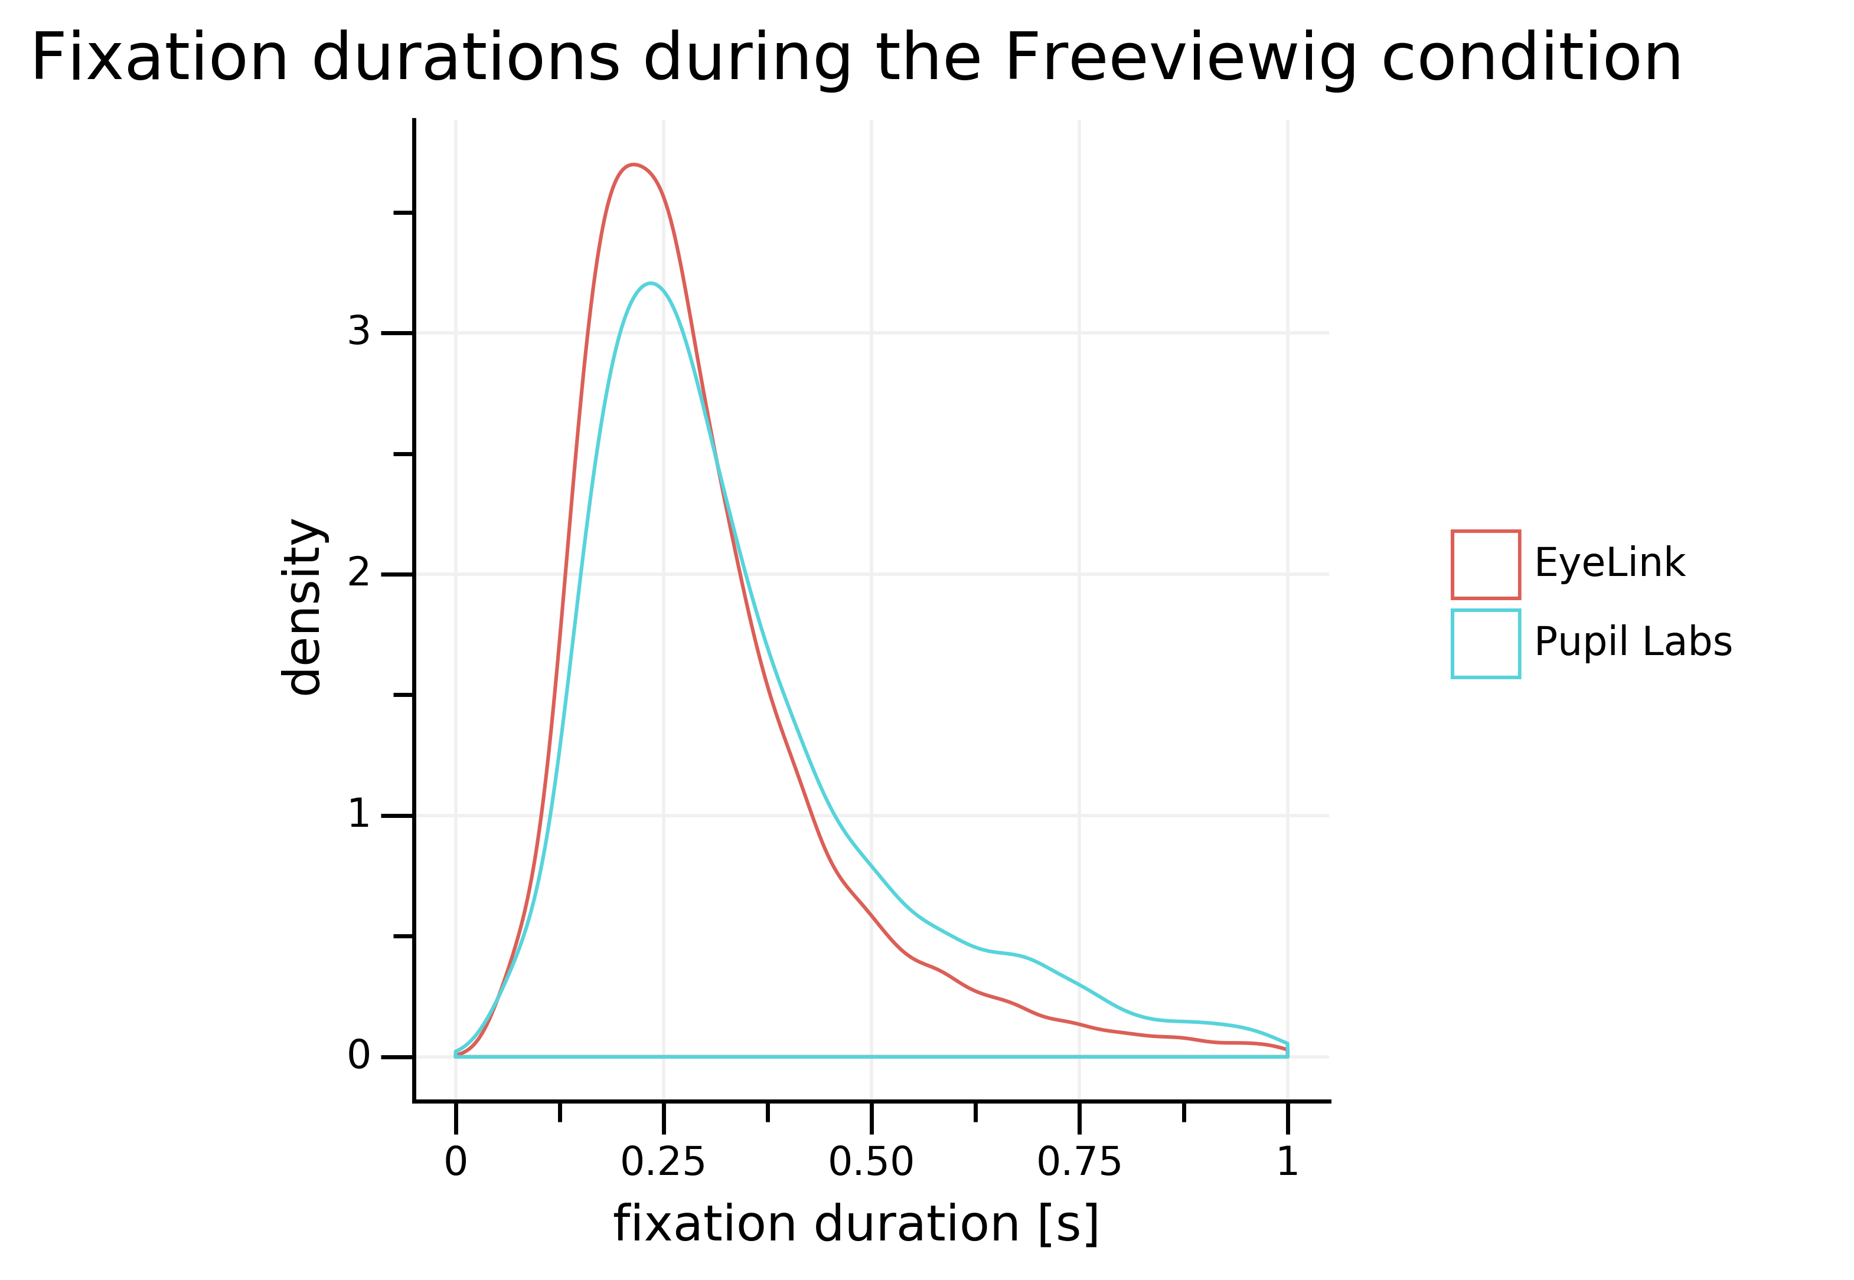
Freeviewing

Slide 19
Take-home message
Don’t trust accuracies reported my the manufacturers blindly!³
    don’t count on better mean performance than:
    ~ 0.9° for EyeLink and ~ 1.3° for Pupil Labs
    qualitative agreement of raw signal is surprisingly good
    mind interactions between eyetrackers and detection algorithms
* paper verlinken Holmqvist 2016
Notes:
- think about inaccurate gaze data when designing your experiment
- accuracy for pupil labs is around and degrees for eyelink under lab conditions
- gaze data quality is very subject and block dependent
(et macht aber grßen unterschied (et kann man aussuchen, subject nicht) [pupil labs macht aber gar nicht so einen schlechten job: nur 1.8 mal schlechter]

Slide 20
Thank you!
Notes:
So there is still a lot of work left and I appreciate any comments and help
Thank you for your attention
Questions?
| | Pupil Labs | EyeLink 1000 |
|-----------------------|--------------|-----------------|
| accuracy | 0.6&deg; | 0.25 - 0.5&deg; |
| temporal resolution | 120 Hz | 500 Hz |
| principle | binocular recording | monocular recording |
| | EyeLink 1000 | Pupil Labs |
|------------------------------------|-----------------------------------|-------------------------------|
| accuracy (value from manufactorer) | 0.25 - 0.5 degree of visual angle | 0.6 degree of visual angle |
| precision | 0.01 degree RMS | 0.08 degree RMS |
| temporal resolution | 1000 Hz | 120 Hz |
| principle | monocular | binocular |
| method | Dark Pupil Corneal Reflection | Dark Pupil Corneal Reflection |
| pupil detection | Ellipse fitting | Pupil Labs |
| | | |

Slide 21
Referecences
¹ paper verlinken Holmqvist 2016
² paper verlinken Holmqvist 2016
³ paper verlinken Holmqvist 2016

